Slide 1
Identity in ASP .Net Core 3.0
Dương Thanh hùng

Slide 2
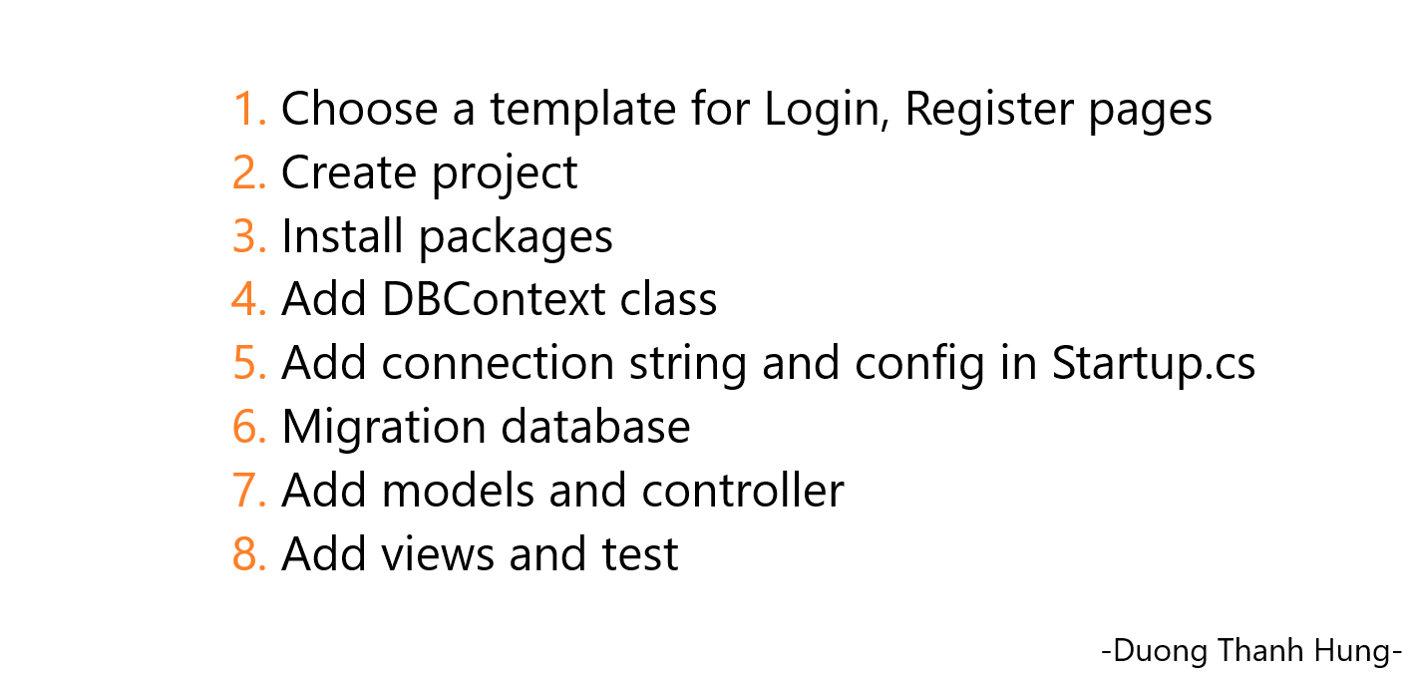

Slide 3
1. Choose a template
LINK 1000p: https://startbootstrap.com/themes/sb-admin-2/

Slide 4
Create Project
HELLO WORLD

Slide 5
Install package
List packages:
Microsoft.AspNetCore.Identity
Microsoft.AspNetCore.Identity.EntityFrameworkCore
Microsoft.AspNetCore.Identity.UI
Microsoft. EntityFrameworkCore
Microsoft. EntityFrameworkCore.Analyzers
Microsoft. EntityFrameworkCore.Design
Microsoft. EntityFrameworkCore.Relational
Microsoft. EntityFrameworkCore.SqlServer
Microsoft. EntityFrameworkCore.Tools

Slide 6
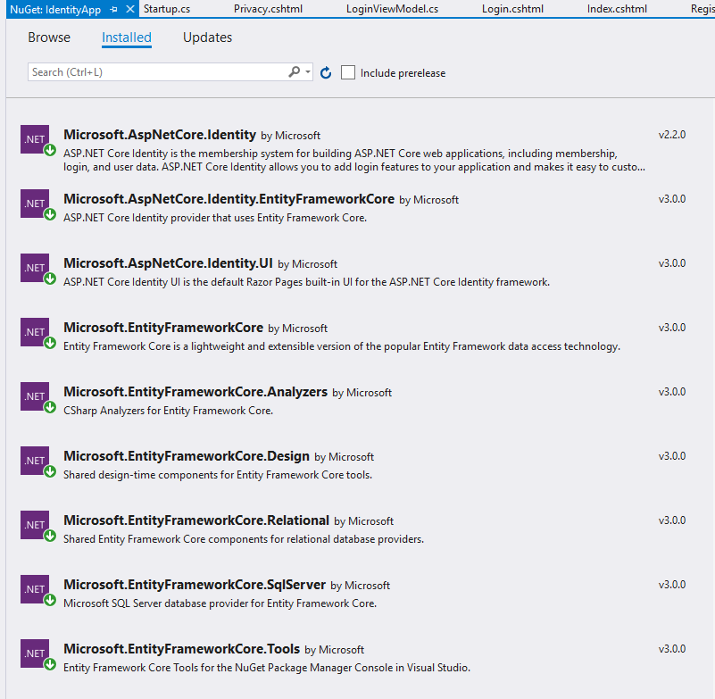

Slide 7
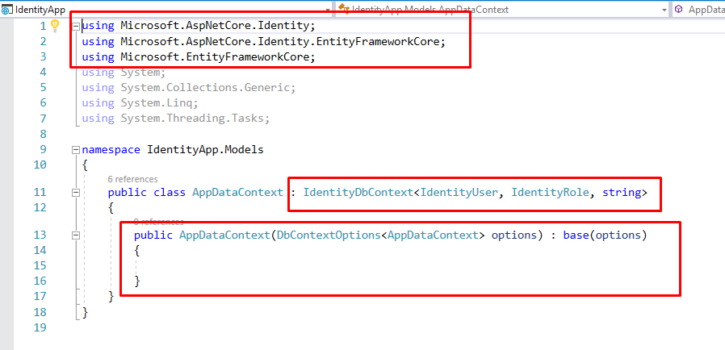
AppDataContext class

Slide 8
Add connection string to file appsetting.json
"ConnectionStrings": {
"IdentityApplication" : "Server=(localdb)\\ProjectsV13;Database=IdentityApps;Trusted_Connection=True;"
}

Slide 9
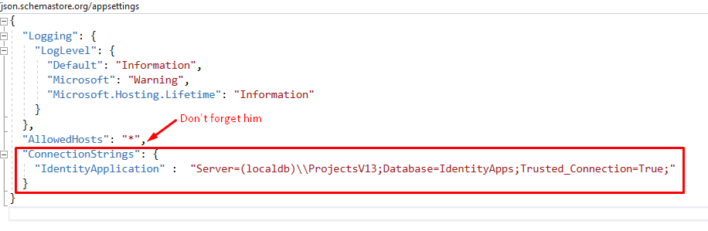

Slide 10
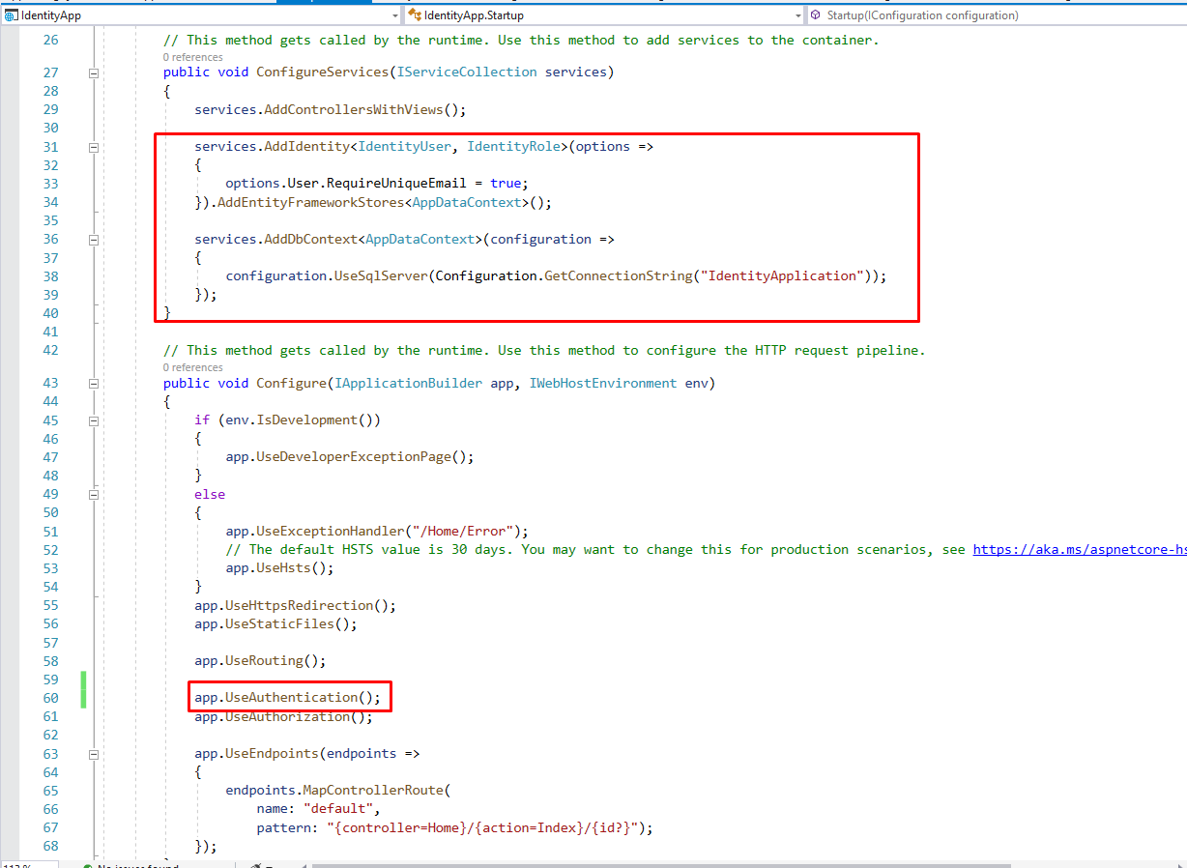
Startup class

Slide 11
Migration
Create a null Database
Open Package Manager Console > run Add-Migration InitIdentity command
Run Update-Database command to generate database

Slide 12
Create ViewModels
Create new folder in your project and named “ViewModels”
In ViewModels folder, add 2 files RegisterUserViewModel.cs and LoginViewModel.cs

Slide 13
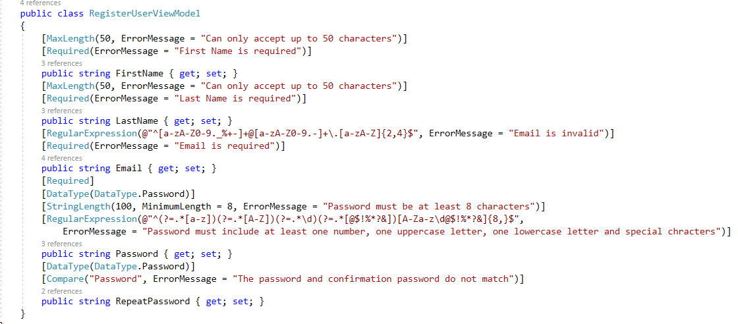
RegisterUserViewModel.cs file

Slide 14
^[a-zA-Z0-9._%+-]+@[a-zA-Z0-9.-]+\.[a-zA-Z]{2,4}$
Regex for email

Slide 15
Regex for password
^(?=.*[a-z])(?=.*[A-Z])(?=.*\d)(?=.*[@$!%*?&])[A-Za-z\d@$!%*?&]{8,}$

Slide 16
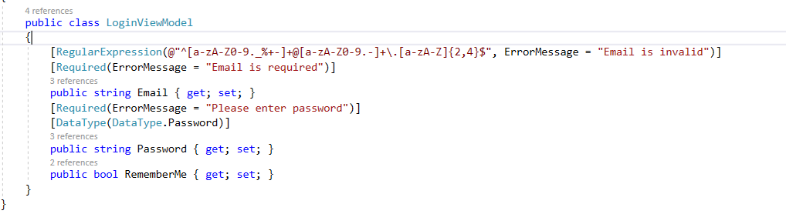
LoginViewModel.cs contents

Slide 17
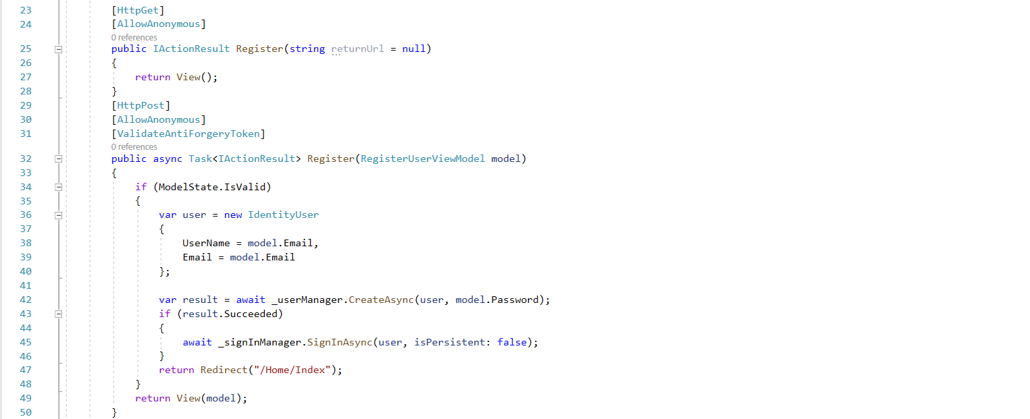
Register

Slide 18
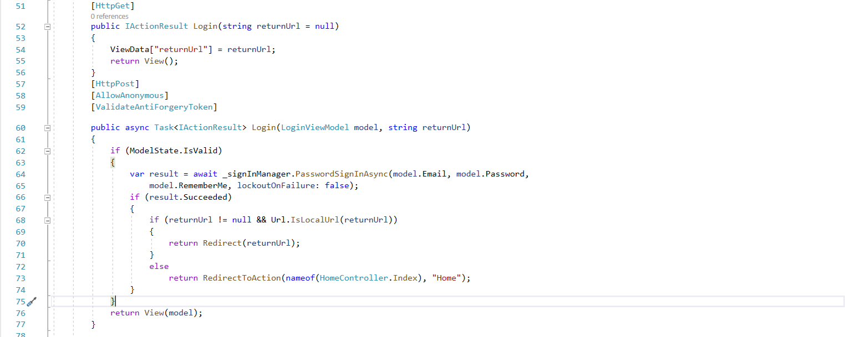
Login

Slide 19
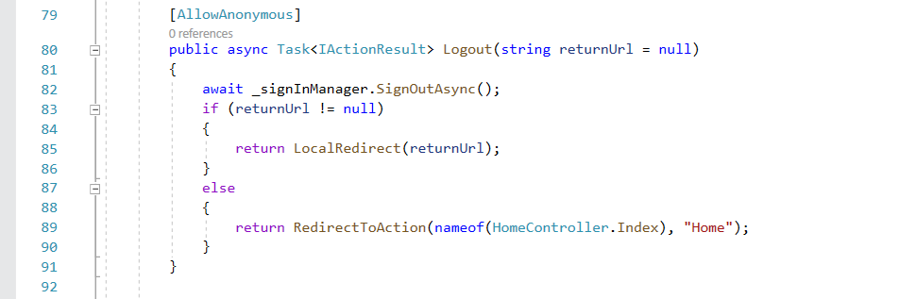
Logout

